Slide 1
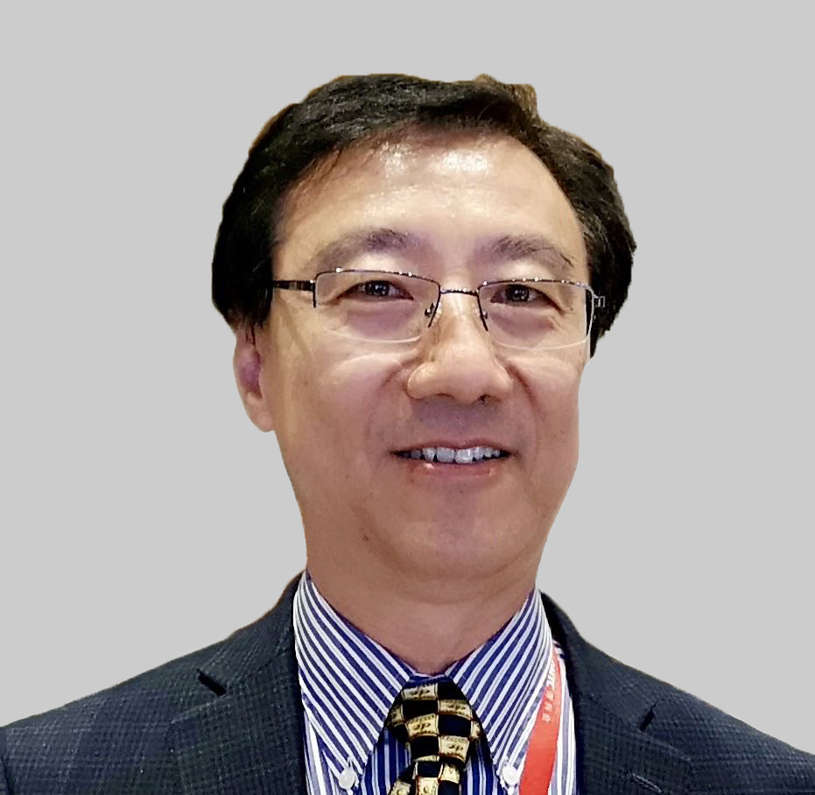
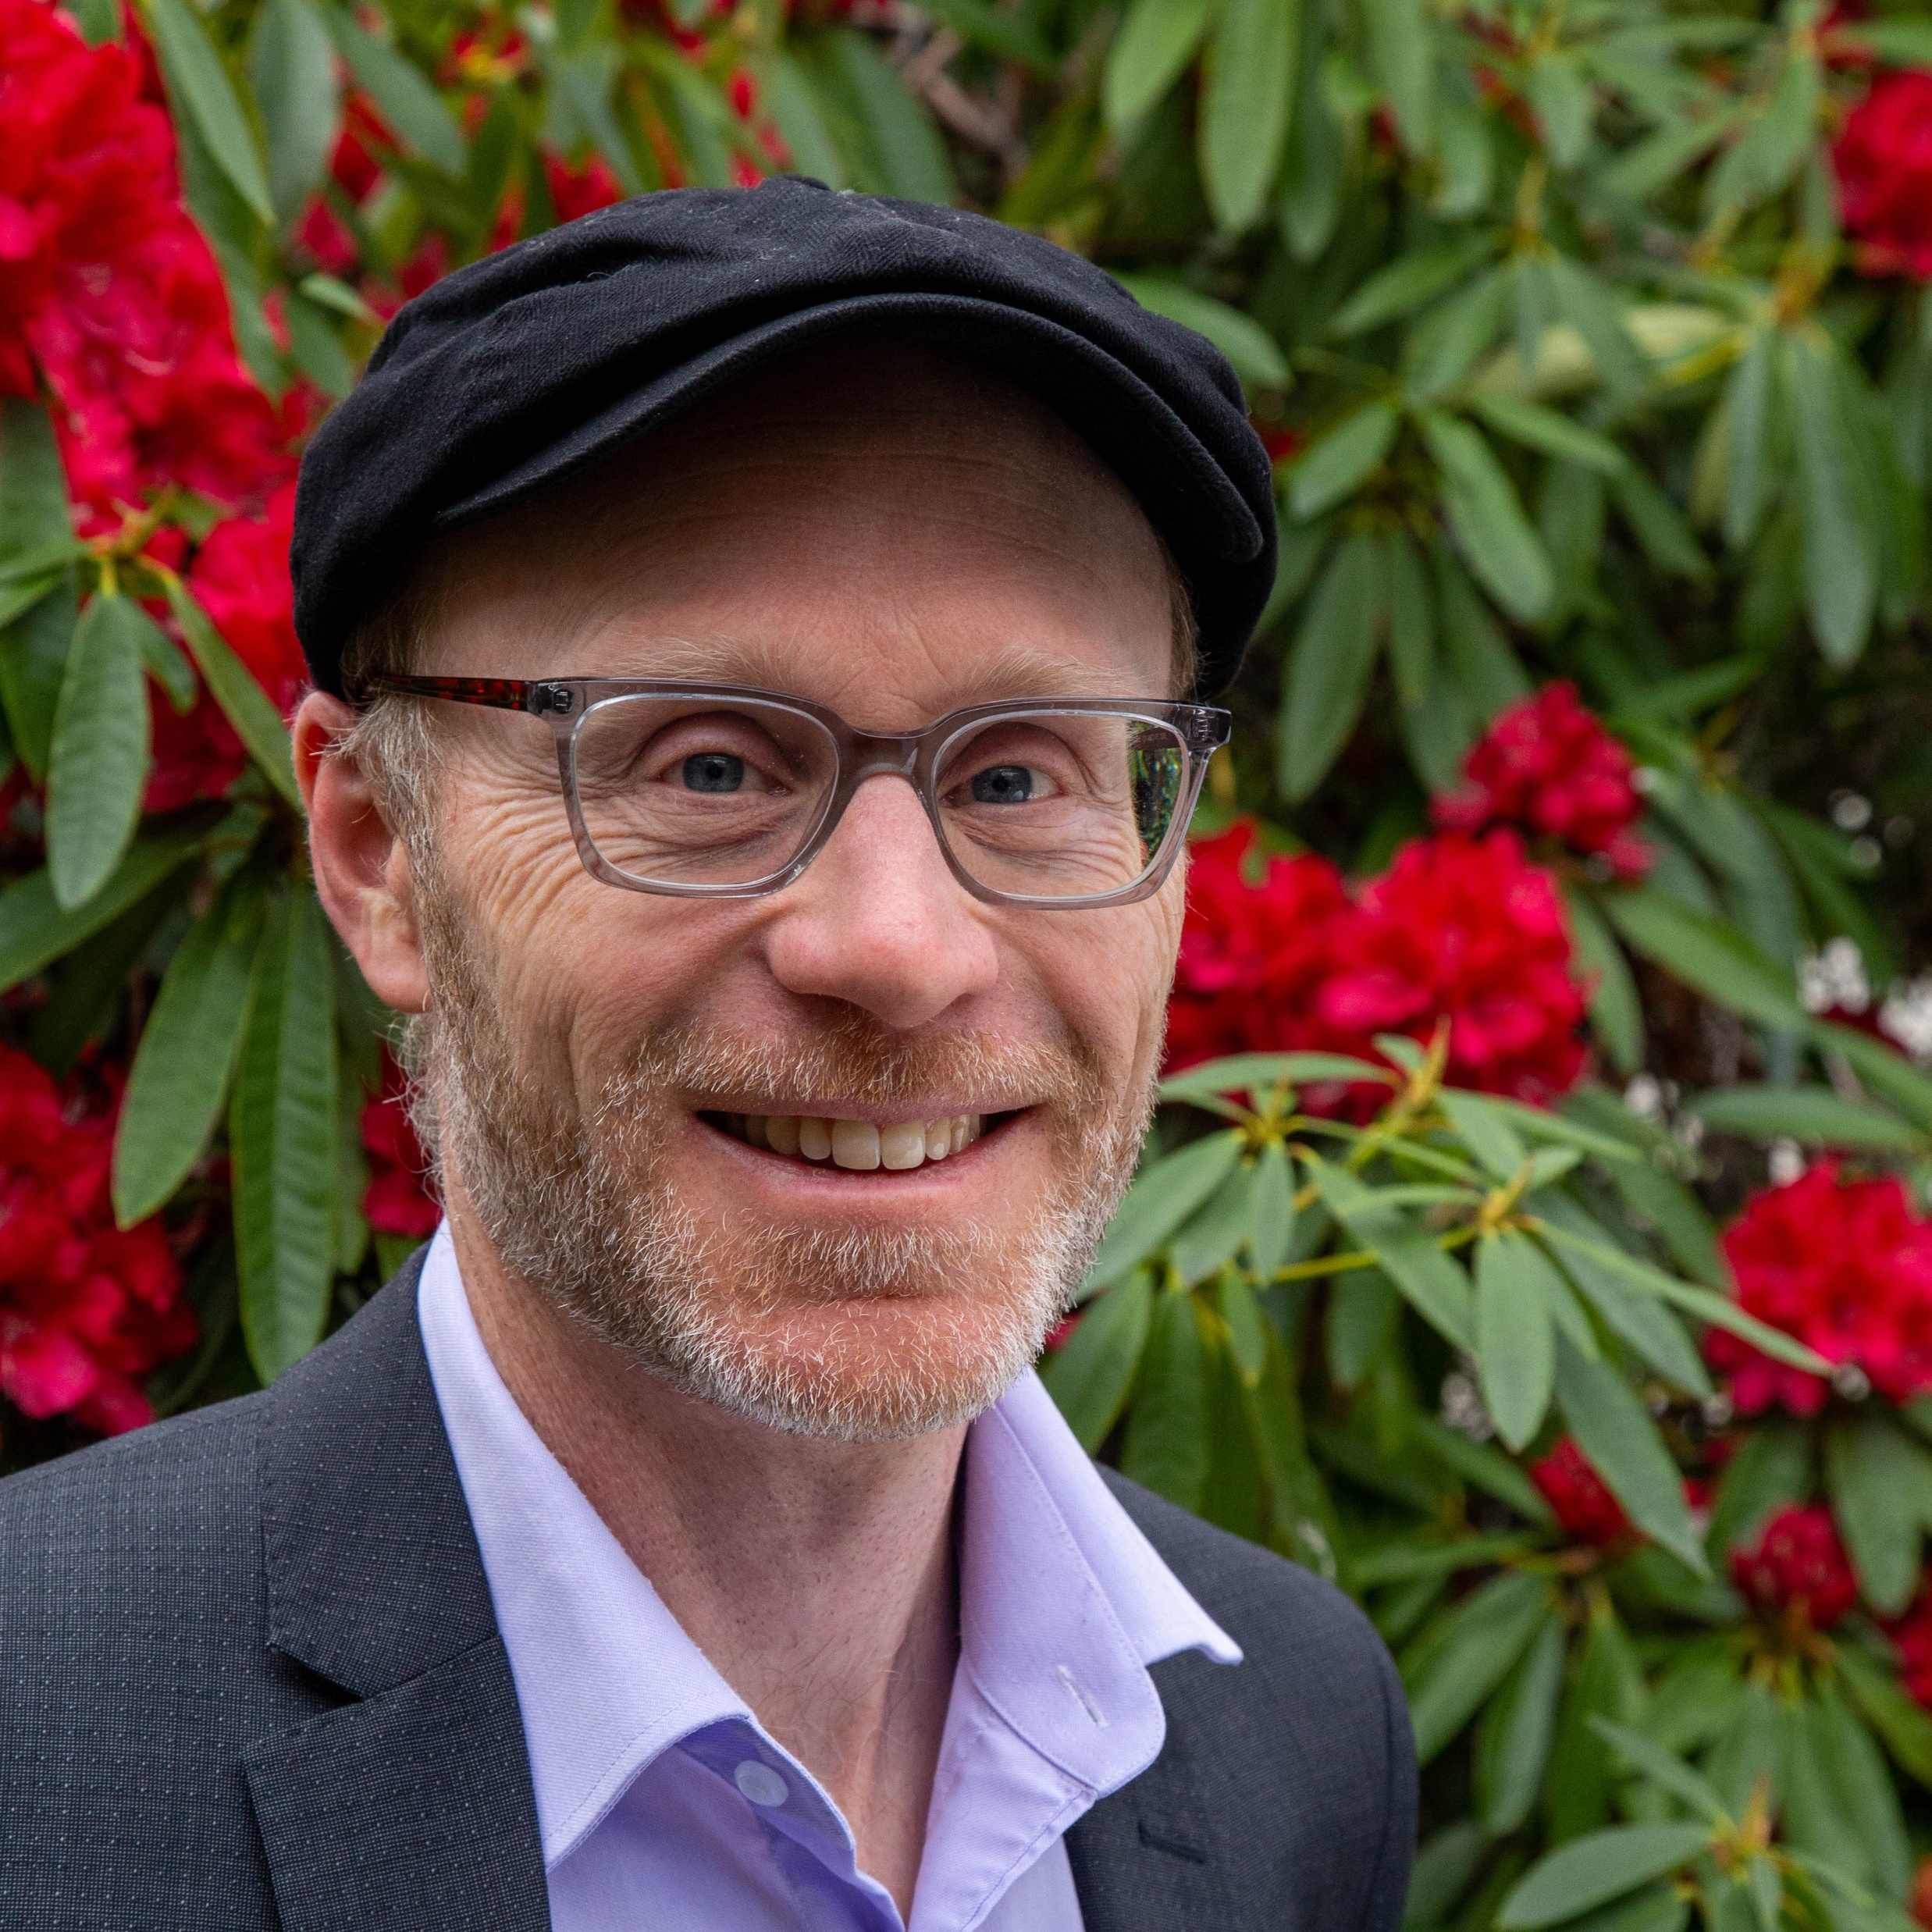
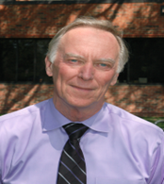
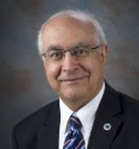


The 4th International Flavor and Fragrance Conference
(November 4-7, 2024, Auckland, New Zealand)
https://avenues.eventsair.com/international-flavor-and-fragrance-conference-2024
Scientific Committee:
Dr. Gary Reineccius, University of Minnesota, USA
Dr. Michael Qian, Oregon State University, USA
Dr. Graham Eyres, University of Otago, New Zealand
Dr. Fereidoon Shahidi, Memorial University of Newfoundland, Canada
Dr. Keith Cadwallader, University of Illinois, USA
Dr. Robert McGorrin, Oregon State University, USA
Dr. Philip Marriott, Monash University, Australia
Dr. Kelly Wilkinson, The University of Adelaide, Australia
Dr. Janusz Pawliszyn, University of Waterloo, Canada
Dr. Thierry Thomas-Danguin, CSGA – INRAE, France
Dr. Coralia Osorio Roa, Universidad Nacional de Colombia, Colombia
Dr. Jonathan Beauchamp, Fraunhofer Institute for Process Engineering and Packaging IVV, Germany
Organizing committee:
Dr. Michael Qian
Oregon State University
USA
Dr. Graham Eyres
University of Otago
New Zealand
Dr. Gary Reineccius
University of Minnesota
USA
Dr. Fereidoon Shahidi
Memorial University of Newfoundland
Canada

